Slide 1



ecx.io Frontend Bootcamp — CSS Day 6 04.08.2021.

Slide 2



Introduction round

Slide 3
Agenda
SASS
Intro
Nesting
.sass vs .scss
Modules
Variables
Maps
Extend
Mixins

Slide 4
Intro

Slide 5
SASS
Syntactically Awesome Style Sheets
Sass is a preprocessor scripting language that is interpreted or compiled into Cascading Style Sheets.
Sass is the most mature, stable, and powerful professional grade CSS extension language in the world.
Notes:
Or as some use to call it: Super Awesome Sexy Stylesheets
SassScript is the scripting language itself.

Slide 6
SASS
SASS as a CSS preprocessor allows us to use many features of "real" programming languages such as variables, custom functions, imports, nesting and more.
Plainly said, it extends the core functionality of CSS and enables many advanced functionalities and principles that normally wouldn't be available.
Notes:
By default, SASS/SCSS files cannot be read by the browser.
It requires an additional step - the compilation - to translate the code to plain CSS that is readable by all browsers.
Your project needs to include a compiler that will "translate" the SASS code into plain CSS.
Despite the extra setup needed, SASS gives us access to features that make our CSS code easier to write an maintain.
Stylesheets are getting larger, more complex, and harder to maintain. -This is where a preprocessor can help.

Slide 7
Installation

Slide 8
SASS: Installation
npm install -g sass
Notes:
Considering we have Node.js installed (npm with it comes automatically), we are able to run following command.
If you do not have Node.js installed we should install it, preferably via Homebrew, but direct installation is also fine.
There is a brew package `brew install sass/sass/sass` -but that would install Dart SASS, we will not work on it today.

Slide 9
Nesting

Slide 10
Nesting
SASS lets us write selectors in a clear, structured way - similar as the visual hierarchy in HTML looks like.
Going deeper than three levels (not counting pseudo elements and selectors) is considered a bad practice.
Notes:
We can nest our CSS selectors in a way that follows the same visual hierarchy of our HTML, but we must be aware that overly nester rules will increase specificity and could prove hard to maintain.

Slide 11
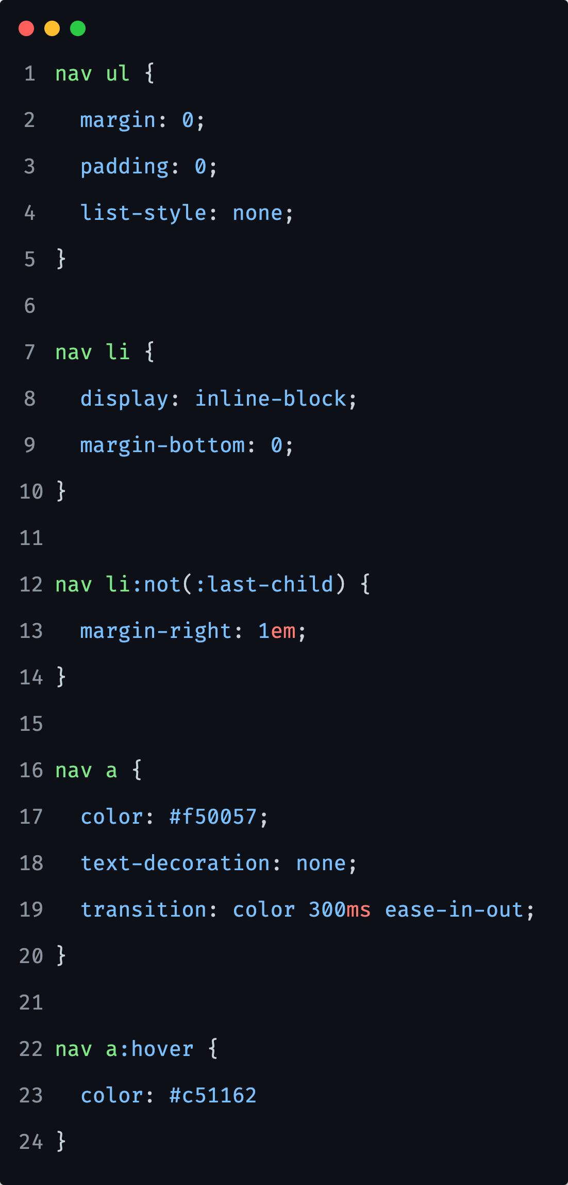
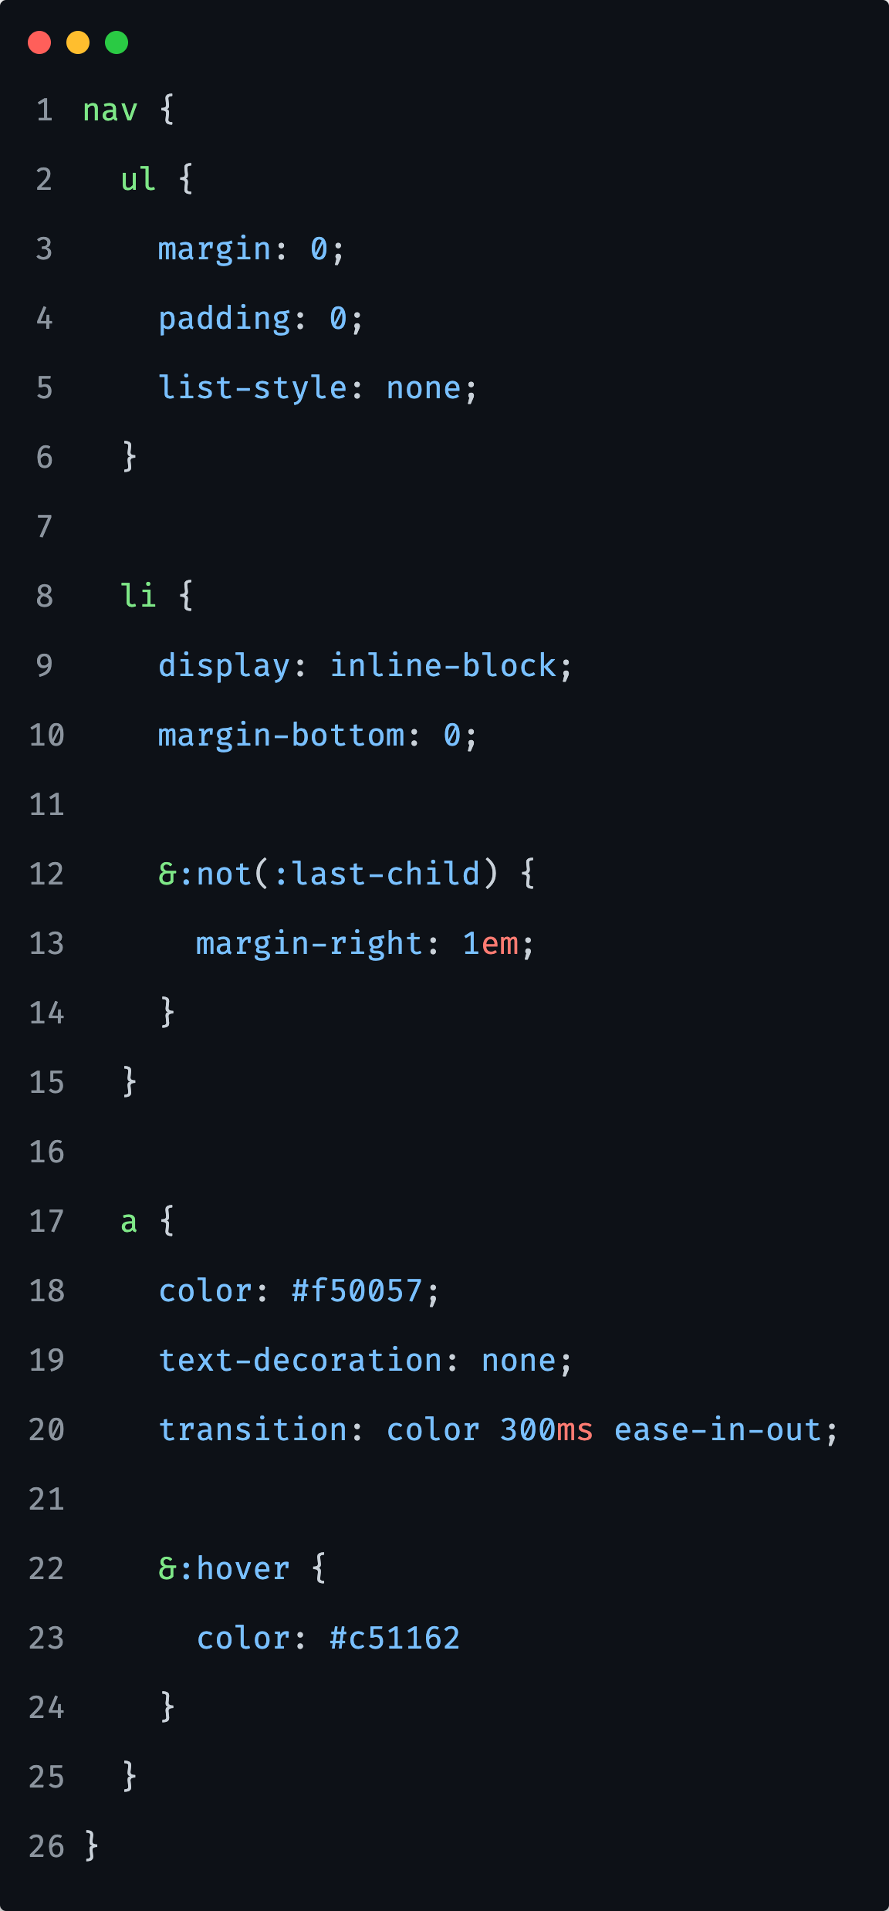
Nesting: CSS vs SCSS
Notes:
We can see that when using SASS nesting, the code is more lean and readable. It also follows the hierarchical structure of the markup.
One thing that you may have noticed is the & operator. It is called the parent selector and will be described into more detail in the upcoming section.

Slide 12
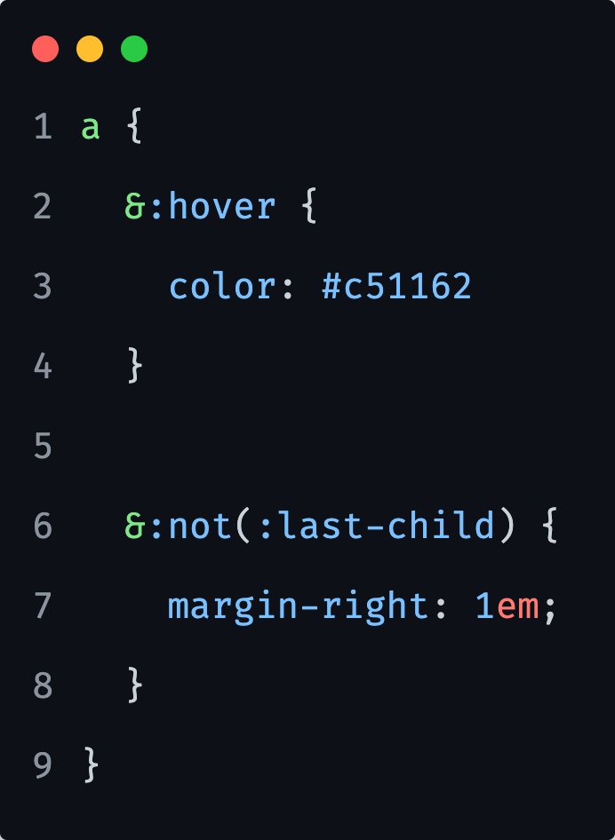
Parent selector
The parent selector: & Is a special selector invented by SASS that is used in nested selectors to refer to the outer selector.
It makes it possible to re-use the outer selector in a more complex way and it is very useful when working with:
- pseudo-selectors
- pseudo-classes
- the BEM methodology

Slide 13

PDF Task
Notes:
15 minutes
Task reference: css/06/04-Nesting/exercises/readme.pdf

Slide 14
SASS vs SCSS

Slide 15
SASS vs SCSS
The SASS preprocessor comes into two syntaxes - SCSS and SASS.

Slide 16
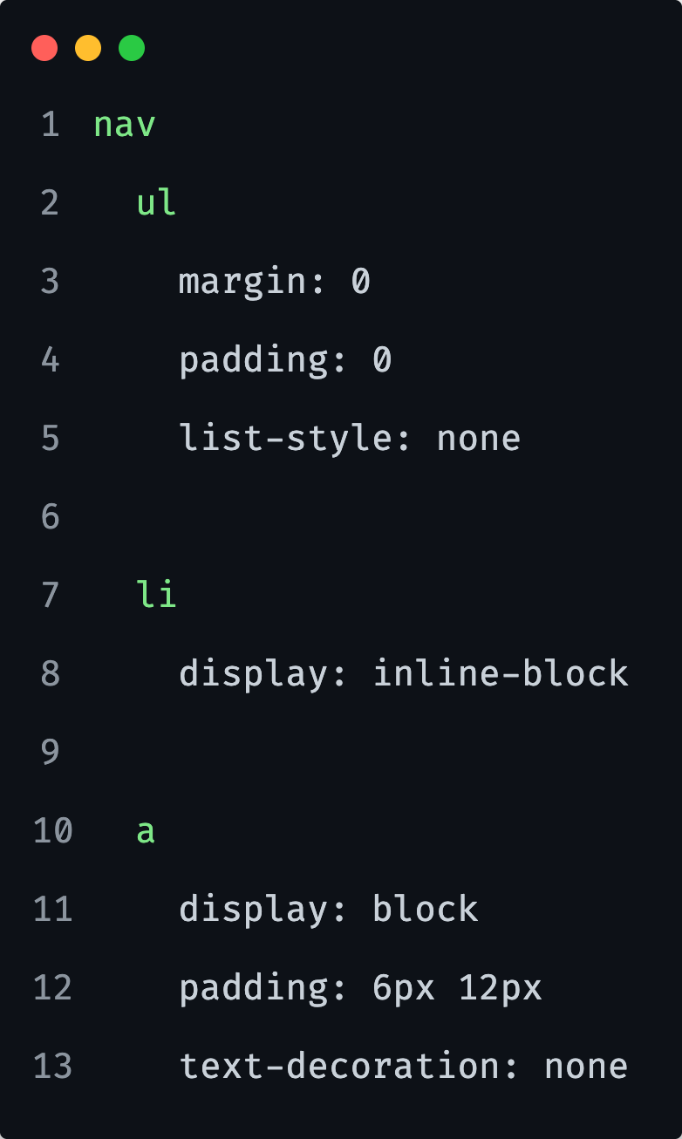
SASS syntax
We can see that curly braces and semicolons aren't used - everything is based on indentation.
Notes:
While this saves us keystrokes, in the long run when we're working on large components, this approach can be confusing and it could be hard to identify a clear hierarchy of selectors.
You will mostly see this on Medium articles or alike…not so much on real projects.

Slide 17
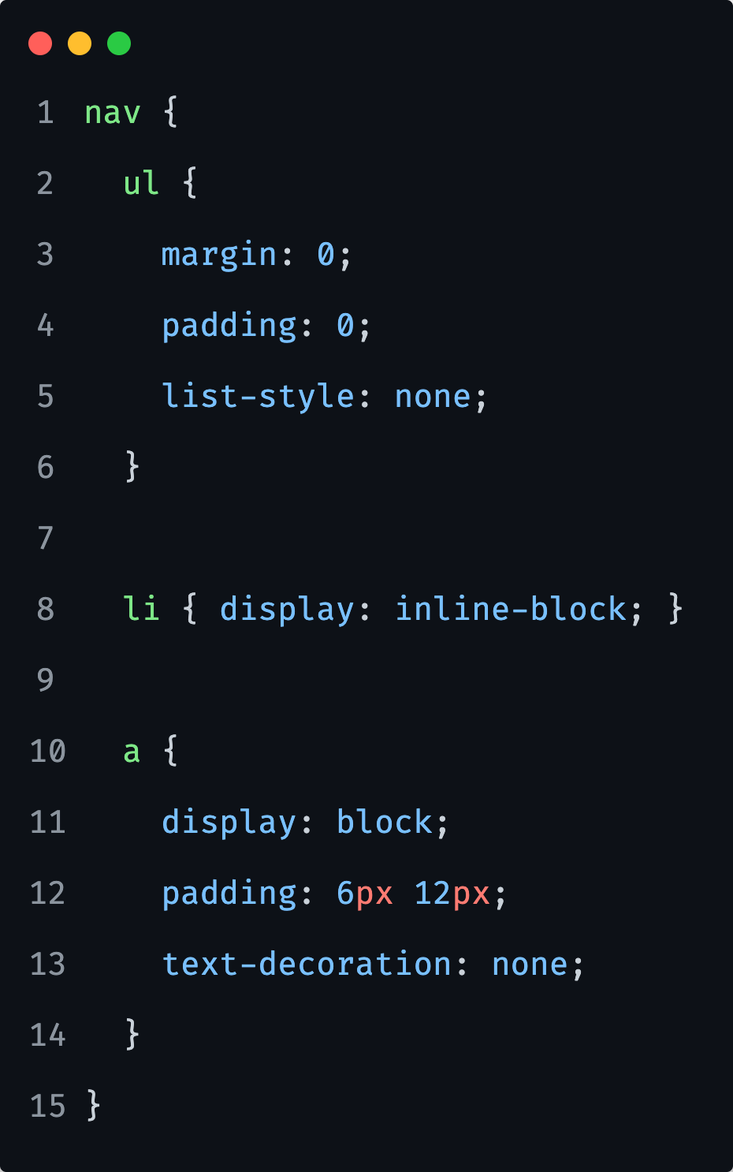
SCSS syntax
It is very similar to plain CSS with the difference that we can nest selectors.
Usually when we say SASS, we mean SASS as a preprocessor but SCSS as a syntax.
Notes:
While this saves us keystrokes, in the long run when we're working on large components, this approach can be confusing and it could be hard to identify a clear hierarchy of selectors.

Slide 18
Modules

Slide 19
Modules
Important feature of SASS is the possibility to split our styling over multiple files.
SASS extends CSSs @import at-rule with the ability to import SASS and CSS stylesheets, combining multiple stylesheets together.
Notes:
Unlike plain CSS imports, which require the browser to make multiple HTTP requests as it renders the website, SASS imports are handled entirely during compilation.

Slide 20
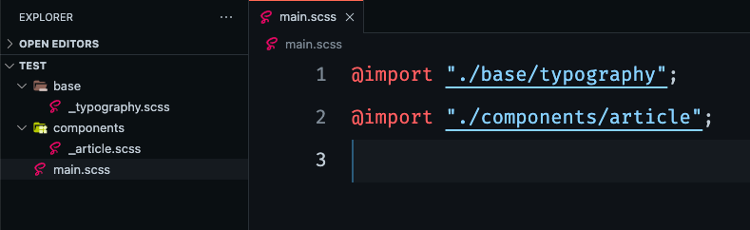
Modules: Import example

Slide 21
Variables

Slide 22
Variables
One of the most powerful features of SASS is the usage of variables.
Variables make it possible to reduce repetition, do complex math, configure libraries, and much more.
Notes:
SASS isn't a strongly typed language, so any value can be assigned to a variable and used throughout the code - the only thing that we need to pay attention to is that the variable must be declared before it is called in the code.

Slide 23
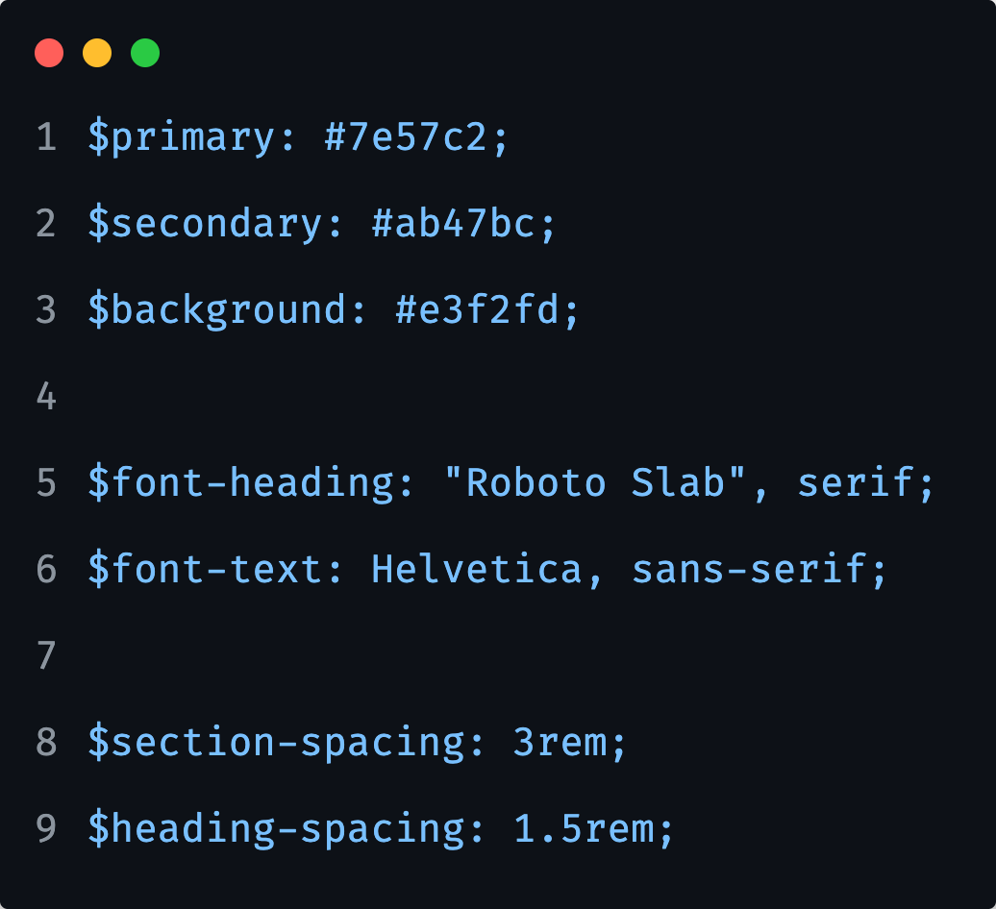
Variables
Think of them as a way to store information that you want to reuse throughout your stylesheet. We can store things like colors, font stacks, or any CSS value that could be reused.
Notes:
When the SASS is compiled, it takes the variables we defined above and outputs normal CSS with our variable values placed in the CSS.
This can be extremely powerful when working with brand colors, spacings and similar settings to keep them consistent throughout the project.

Slide 24
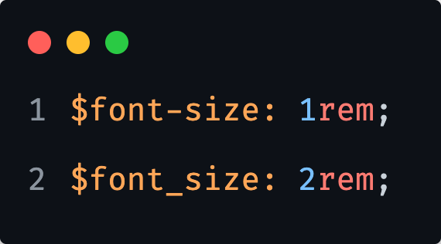
Variables
Keep in mind that like all SASS identifiers, variables treat hyphens and underscores as identical.
This means that $font-size and $font_size both refer to the same variable.

Slide 25
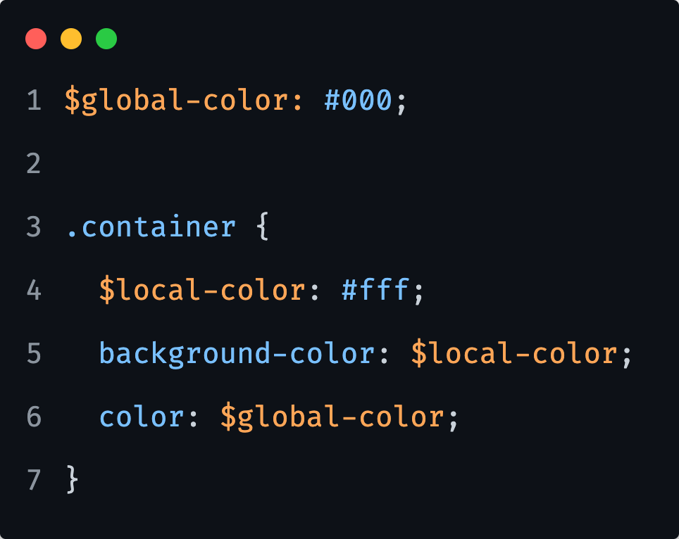
Variables and Scope
Variables declared at the top level of a stylesheet are global, meaning that they can be accessed anywhere in their module after they’ve been declared.
This behavior is not true for all variables - those that are declared in blocks (curly braces in SCSS or indented code in SASS) are considered local and can only be accessed within the block they were declared.
Notice that this is very similar to the way that JavaScript handles its variable scopes.
Notes:
This will work perfectly, because the .container selector has access to both the $global-color and the $local-color variables, so their values will be interpreted correctly.

Slide 26
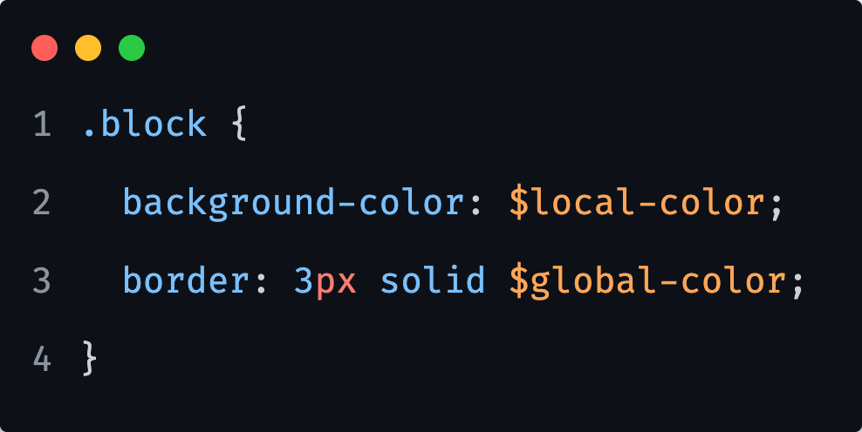
Variables and Scope
This code will fail because the .block selector does not have access to the $local-color variable.
$local-color is accessible only in the .container selector.

Slide 27
Variables and Shadowing
Local variables can even be declared with the same name as a global variable.
If this happens, there are actually two different variables with the same name: one local and one global.
This helps ensure that an author writing a local variable doesn’t accidentally change the value of a global variable they aren’t even aware of.

Slide 28
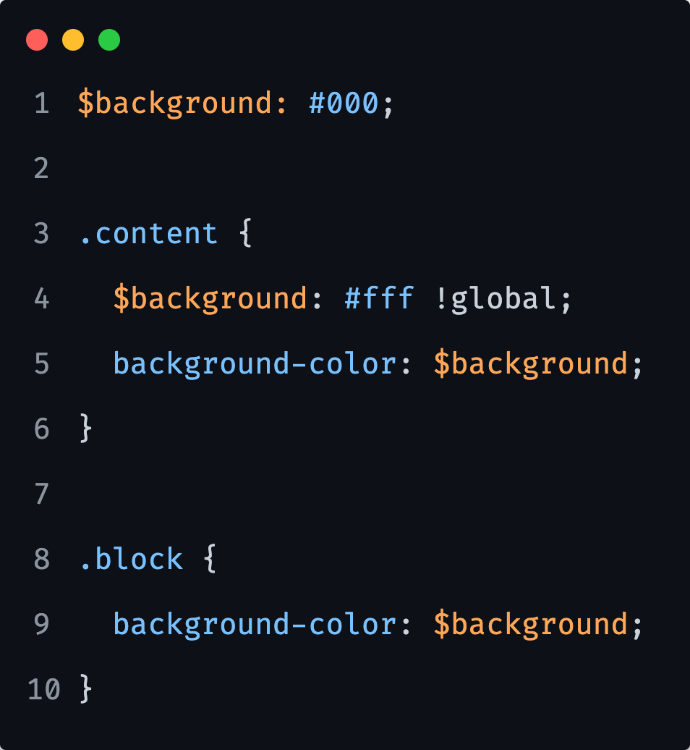
Variables and Shadowing
If we would need to set a global variable’s value from within a local scope (such as in a mixin), we can use the !global flag.
A variable declaration flagged as !global will always assign to the global scope.
Note that the !global flag may only be used to set a variable that has already been declared at the top level of a file.
It may not be used to declare a new variable.
Notes:
So basically, with code above, we are overwriting the global $background variable from within a `.content` block, with `!global! Flag.

Slide 29
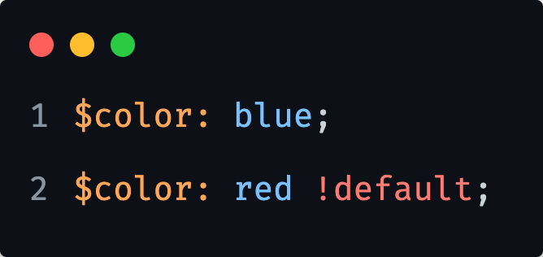
Variables and Defaults
Normally when you assign a value to a variable, if that variable already had a value, its old value is overwritten.
But if we are writing a SASS library, we might want to allow the users to configure the library’s variables before they are used to generate CSS.
To make this possible, SASS provides the !default flag. This assigns a value to a variable only if that variable isn’t defined or its value is null. Otherwise, the existing value will be used.
Notes:
Note that on the image, without the `!default` flag, the output color would be red and not blue.

Slide 30
PDF Task
Notes:
15 minutes
Task reference: css/06/02-Variables/exercises/readme.pdf

Slide 31
Maps

Slide 32
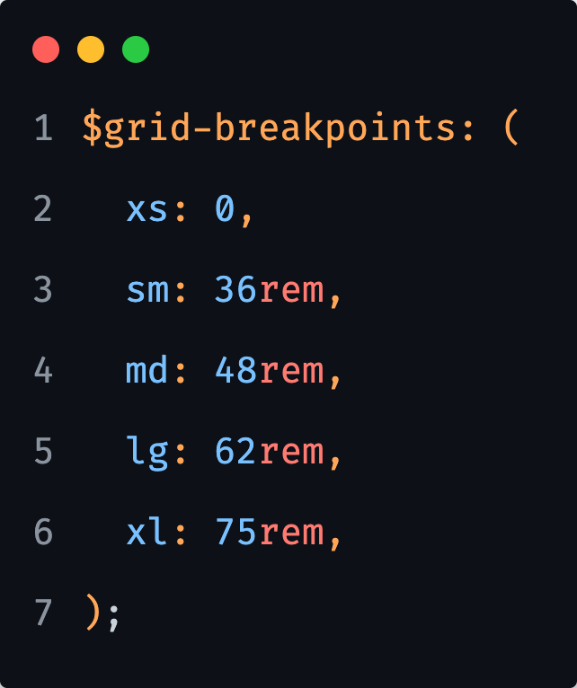
Maps
Maps in SASS hold pairs of keys and values and make it easy to look up a value by its corresponding key.
The expression before the `:` is called the key (e.g. lg), while the expression after is the value associated to that key (e.g. 62rem).
Note that the keys must be unique.
Maps must be written with parentheses around them.
Notes:
Maps allow any Sass values to be used as their keys.
Maps can't do much on their own since they aren't valid CSS values, but SASS provides functions and rules that help us create maps and access or modify the values they contain.

Slide 33
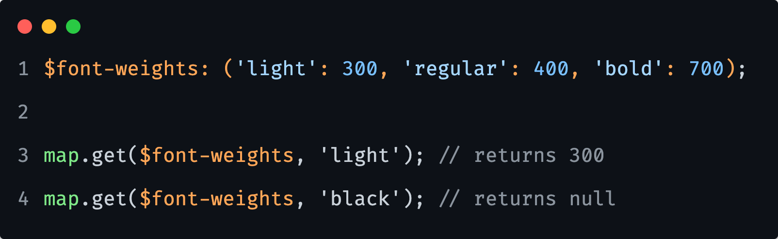
Using Maps
The map.get function returns a value associated with the given key and returns null if the map doesn't contain the key.

Slide 34
PDF Task
Notes:
15 minutes
Task reference: css/06/03-Maps/exercises/readme.pdf

Slide 35
Extend

Slide 36
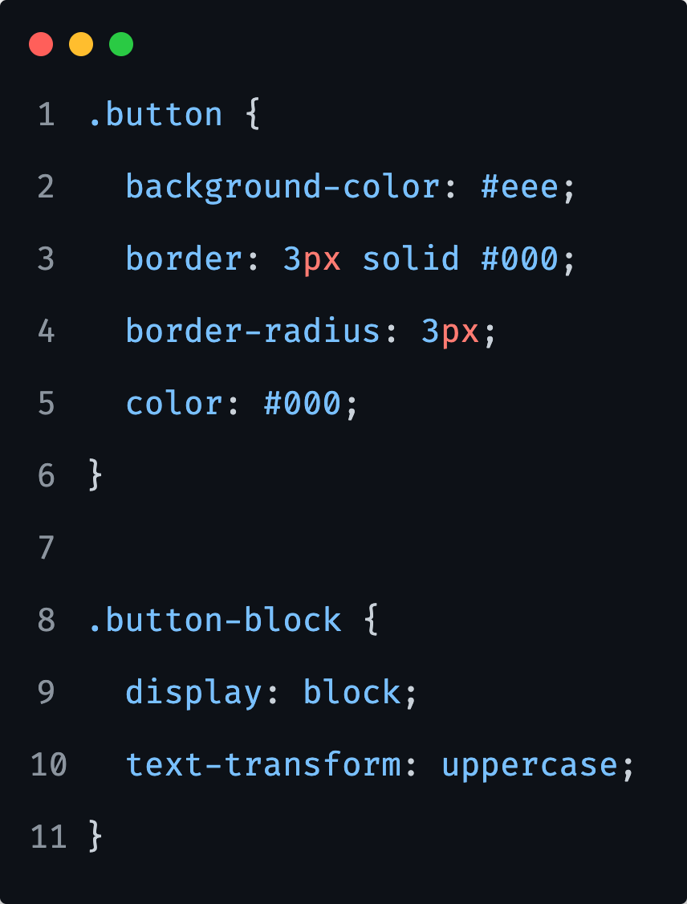
Extend
We will frequently encounter situations where a class should have all the styles of another class with the addition of its own specific styles.

Slide 37
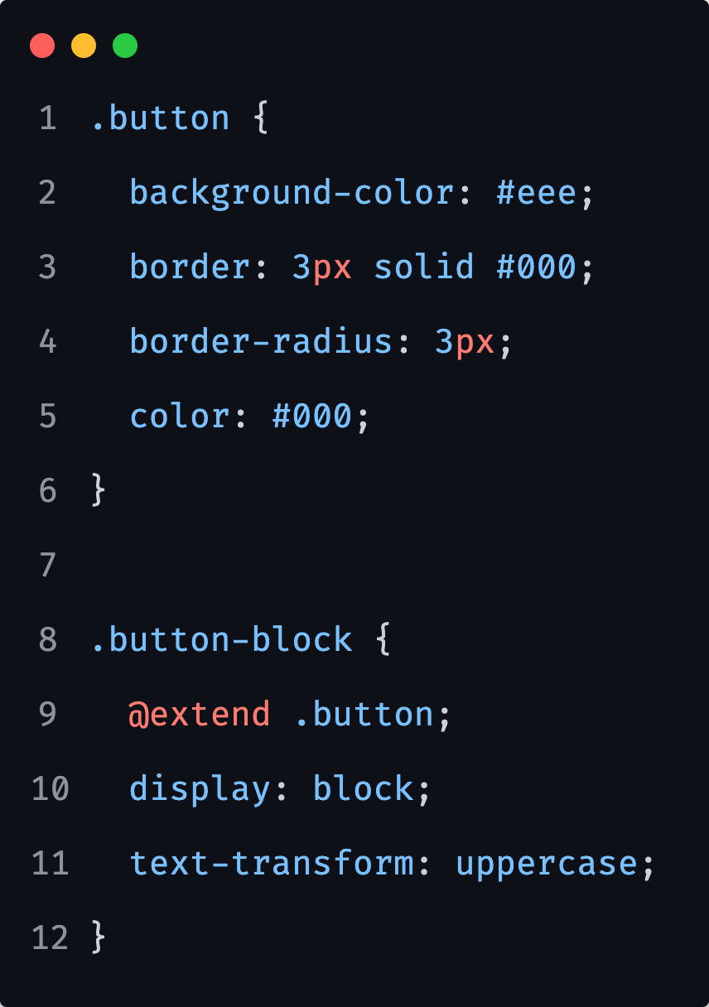
Extend
We will frequently encounter situations where a class should have all the styles of another class with the addition of its own specific styles.
Then we use @extend at-rule that tells SASS that one selector should inherit the styles of another.
Notes:
When one class extends another, SASS styles all elements that match the extender as though they also match the class being extended.
Of course, selectors aren't just used on their own in style rules. SASS knows to extend everywhere the selector is used - this ensures that our elements are styled exactly as if they matched the extended selector.
BEM relation:
However, note that extends are resolved after the rest of our stylesheet is compiled. In particular, it happens after parent selectors are resolved.
This means that if we @extend .error, it won't affect the inner selector in .error { &__icon { ... } }. It also means that parent selectors in SassScript can’t see the results of extend.

Slide 38
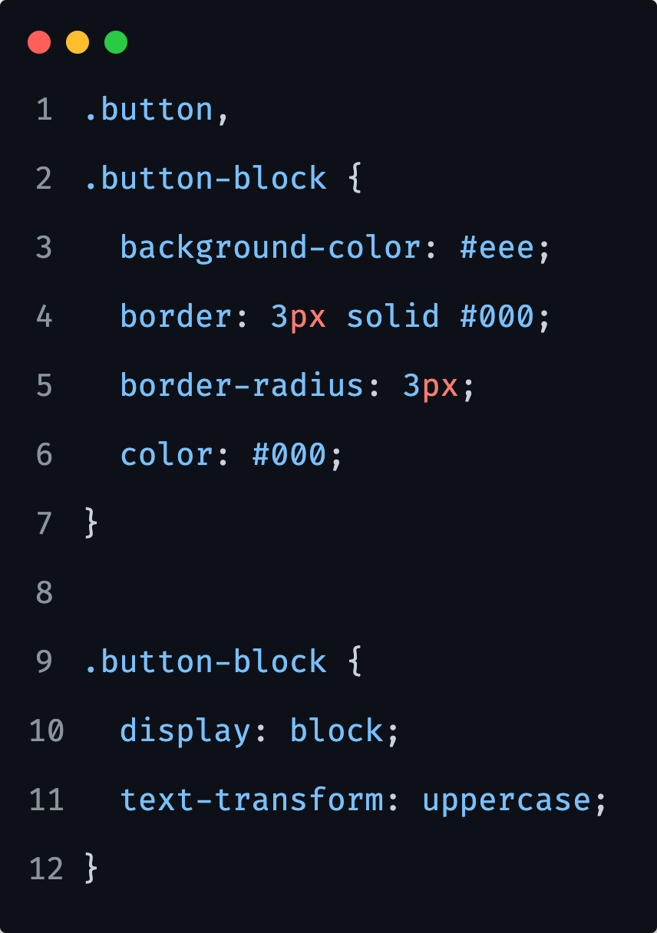
Extend
Output of the @extend at-rule matters, and you should be aware to what it compiles to.
Notes:
The `@extend` at-rule updates styles that contain the extended selector so that they contain the extending selector as well.
This can get pretty messy, as we can have 50 selectors (easy) on a bigger projects.

Slide 39
Extend
We can not use @extend inside media queries.

Slide 40
Extend: Placeholder selectors
Sometimes we want to write a style rule that is only meant to be extended - in that case we can use placeholder selectors.

Slide 41
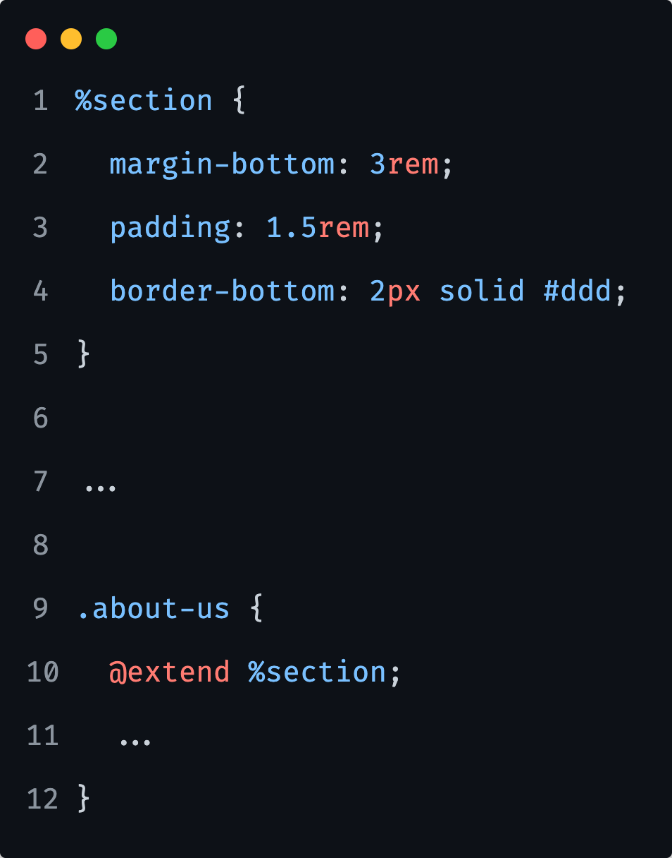
Extend: Placeholder selectors
They look just like class selectors but start with a % sign instead of a . and aren't included in the CSS output, while the selectors that extend them are.
Notes:
Extends are best used when we're expressing a relationship between semantic classes, and we should use mixins when we want to have a repeatable code that is configurable in some way (by passing arguments).

Slide 42
PDF Task
Notes:
15 minutes
Task reference: css/06/05-Extend/exercises/readme.pdf

Slide 43
Mixins

Slide 44
Mixins
A mixin is a powerful feature in SASS that allows us to define styles that can be re-used throughout our stylesheets.
They make it easy to avoid using non-semantic classes (a.k.a. helper classes) like .margin-bottom-3 that are commonly seen in CSS frameworks.
They are also useful for distributing collections of styles in libraries.
Notes:
Mixin to be considered as a function, but not really, as we have functions in SASS as well
Note on helper classes

Slide 45
Mixins
Unlike @extend, we can use @mixin inside media queries.

Slide 46
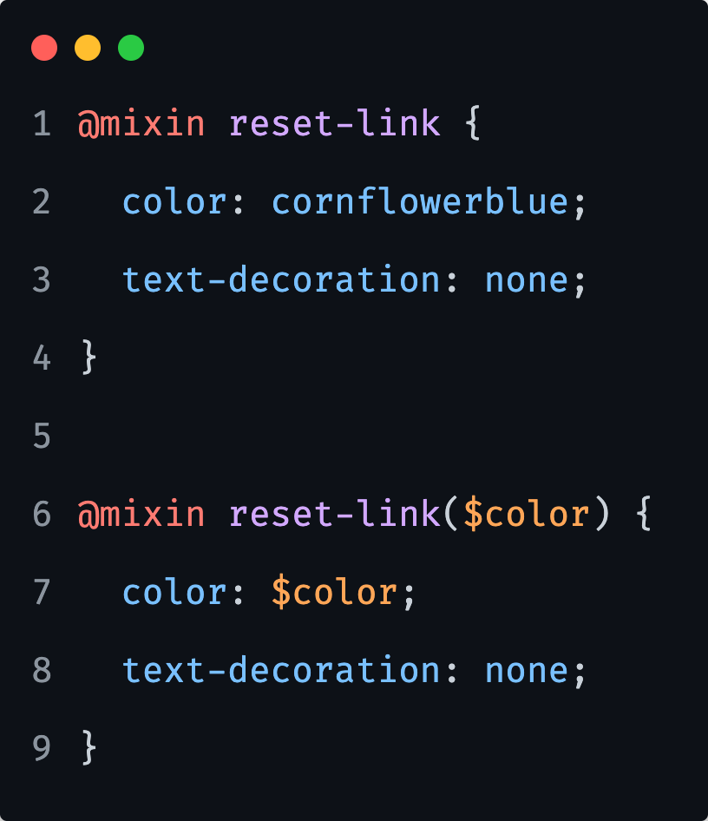
Mixins
Mixins are defined using the @mixin at rule, which must be followed by the name of the mixin and optionally arguments that are passed into it.
A mixin’s name can be any SASS identifier.
They can be used to encapsulate styles that can be dropped into a single style rule.
Notes:
Also, they can contain style rules of their own that can be nested in other rules or included at the top level of the stylesheet, or they can just serve to modify variables.

Slide 47
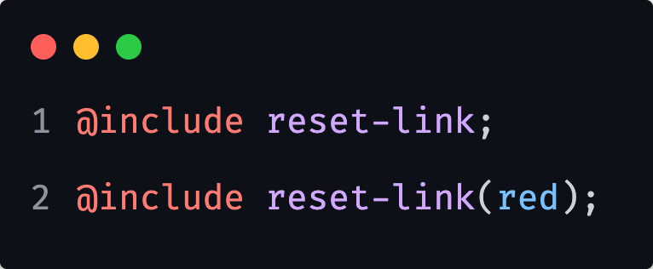
Mixins
Mixins are included into the current context using the @include at-rule, which is written in two ways.
Also, note that mixin names, like all SASS identifiers (we mentioned this on variables), treat hyphens and underscores as identical.
This means that reset-link and reset_link both refer to the same mixin.

Slide 48
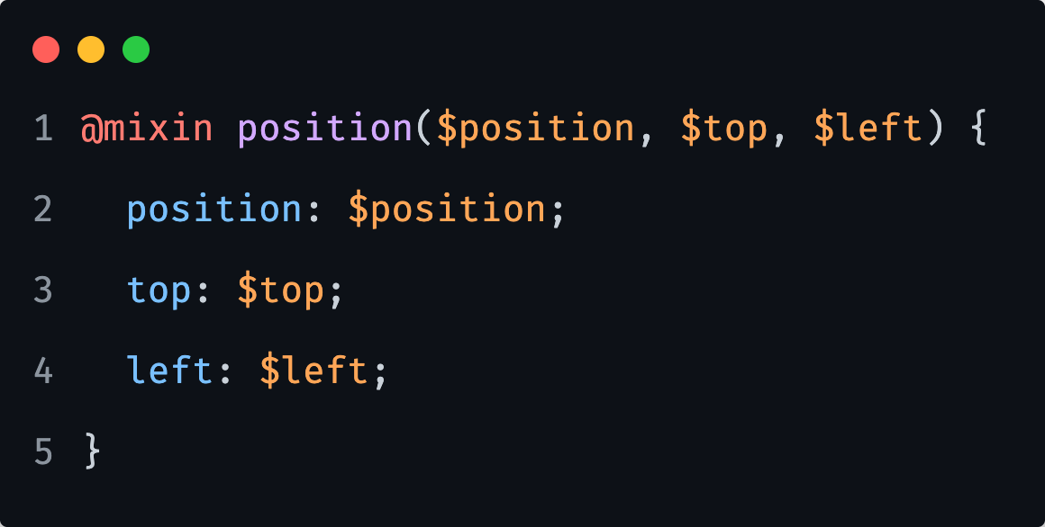
Mixins: Arguments
Mixins can also take arguments, which allows their behavior to be customized each time they’re called.
The arguments are specified in the @mixin rule after the mixin’s name, as a list of variable names surrounded by parentheses.
Notes:
Note that if a mixin has arguments, it must then be included with the same number of arguments in the `@include` call.
The values of these expression are available within the mixin’s body as the corresponding variables.

Slide 49
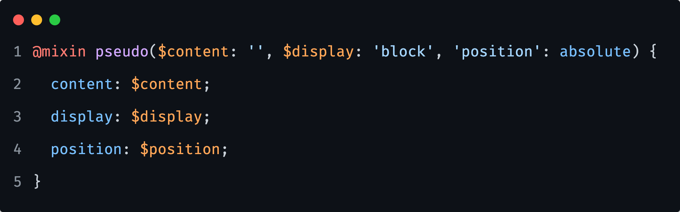
Mixins: Arguments
As previosly stated, every argument a mixin declares must be passed when that mixin is included.
However, we can make an argument optional by defining a default value which will be used if that argument isn’t passed.

Slide 50
Mixins: Arguments
This mixin can be called with just @include pseudo;
In that case the values of `''`, `block` and `absolute` will be assigned to the content, display and position properties respectively.

Slide 51
Mixins: Arguments
However, if we want to pass different values, we can call the mixin like: @include pseudo('test', 'flex', 'relative');

Slide 52
Mixins: Arguments
When a mixin is included, arguments can be passed by name in addition to passing them by their position in the argument list.
This is especially useful for mixins with multiple optional arguments, or with boolean arguments whose meanings aren’t obvious without a name to go with them.

Slide 53
Mixins: Arguments
If we would only like to have a different position property value, we can call the mixin like: @include pseudo($position: relative);

Slide 54
Mixins: Content blocks
Mixins aren't only limited to taking arguments. They can even take an entire block of styles.

Slide 55
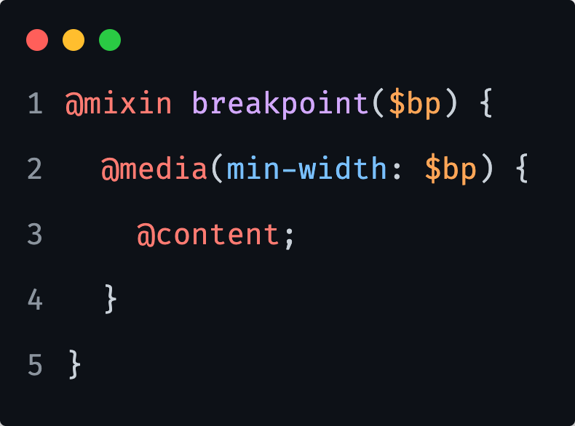
Mixins: Content blocks
Mixins aren't only limited to taking arguments. They can even take an entire block of styles.
This pattern is also known as a content block.
We can declare that a mixin takes in a content block by using the @content at-rule in its body.

Slide 56
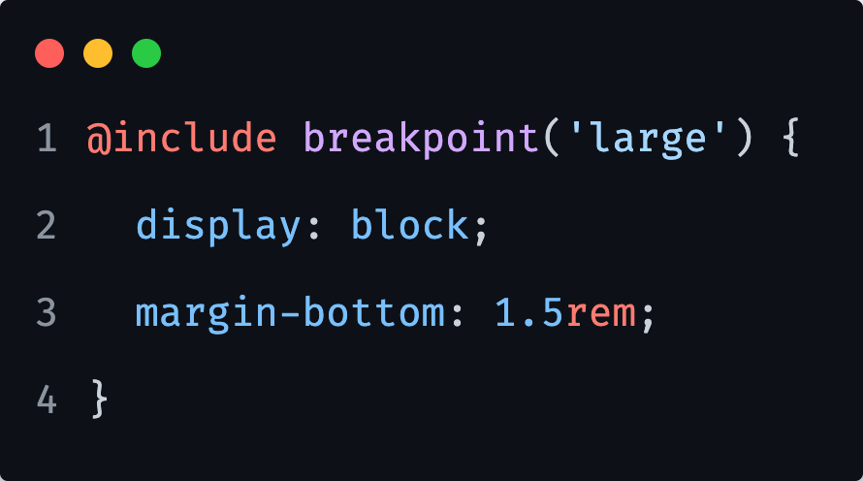
Mixins: Content blocks
To use this media query mixin, we can simply write something like:
Notes:
A mixin can include multiple `@content` at-rules. If it does, the content block will be included separately for each `@content`.
Also note that a content block is lexically scoped, which means it can only see local variables in the scope where the mixin is included.

Slide 57
PDF Task
Notes:
20 minutes
Task reference: css/06/06-Mixins/exercises/readme.pdf

Slide 58
Mixins vs Extend
Harry Roberts from CSS Wizardy suggests:
Use @extend when the rulesets that you are trying to DRY out are inherently and thematically related.
Do not force relationships that do not exist: to do so will create unusual groupings in your project, as well as negatively impacting the source order of your code.
Use a mixin to either inject dynamic values into repeated constructs, or as a Sassy copy/paste which allows you to repeat the same group of declarations throughout your project whilst keeping a Single Source of Truth.

Slide 59
Reference links

Slide 60

Reference links
SASS
https://sass-lang.com/
Nesting
https://css-tricks.com/the-sass-ampersand/
https://www.w3schools.com/sass/sass_nesting.asp
Variables
https://sass-lang.com/documentation/variables
Maps
https://webdesign.tutsplus.com/tutorials/an-introduction-to-sass-maps-usage-and-examples--cms-22184
https://itnext.io/advanced-use-of-sass-maps-bd5a47ca0d1a
Extend
https://sass-lang.com/documentation/at-rules/extend
Mixins
https://scotch.io/tutorials/how-to-use-sass-mixins
https://sass-lang.com/documentation/at-rules/mixin
https://csswizardry.com/2016/02/mixins-better-for-performance/
Crash course on SASS:
https://www.youtube.com/watch?v=nu5mdN2JIwM

